Slide 1


GAME DESIGN PROJECT
TETRIS
BRISTI HALDER
22CD3009

Slide 2
INTRODUCTION
Tetris is a tile-matching puzzle video game originally designed and programmed by Alexey Pajitnov in 1984. It has since become one of the most iconic and recognizable video games of all time.

Slide 3
PIPELINE
Tetriminoes
The fundamental building blocks of Tetris, Tetriminoes are geometric shapes composed of four blocks each. They include classic shapes such as the "T", "L", and "I" pieces, among others.
Tetriminoes fall vertically from the top of the game board and can be rotated and moved horizontally by the player to fit into gaps and create complete lines.

Slide 4
PIPELINE
Initialization
The game initializes by creating a grid or matrix to represent the game board.
Tetrimino Generation
Tetriminos are the falling blocks in Tetris
A random Tetrimino is selected from a predefined set or sequence
The Tetrimino's shape, color, and initial position are determined.

Slide 5
PIPELINE
Piece Movement
The Tetrimino falls downward automatically at a constant speed.
The player can move the Tetrimino horizontally using A, D, and S keys.
The Tetrimino can be rotated clockwise or counterclockwise to fit into gaps using the Q and E keys.
Hard drop is done by the spacebar.

Slide 6
PIPELINE
Ghost Pieces
Ghost pieces are translucent outlines of Tetriminoes that show where the current piece will land if dropped immediately.
They aid in strategic planning by providing visual guidance on potential piece placements.

Slide 7
PIPELINE
Collision Detection
The game checks for collisions between the falling Tetrimino and the existing blocks on the game board.
If a collision is detected:
The Tetrimino stops falling.
Its position is locked, and it becomes part of the game board.
A new Tetrimino is generated for the player to control.

Slide 8
PIPELINE
Line Clearing
The primary objective of Tetris is to clear lines by filling horizontal rows of the game board with Tetriminoes.
When a line is filled, it is cleared from the board, and any blocks above it move down to fill the gap.
Clearing multiple lines simultaneously earns the player bonus points and increases the challenge.

Slide 9
PIPELINE
Scoring
Points are awarded based on the number of lines cleared, with more points earned for clearing multiple lines at once (referred to as "Tetris" for clearing four lines).
Additional scoring opportunities may include achieving combos, dropping Tetriminoes quickly (referred to as "hard drop")

Slide 10
PIPELINE
Difficulty Progression
As the game progresses, the speed at which Tetriminoes falls increases, adding to the challenge.
Players must adapt to the escalating pace and strategically manage the placement of Tetriminoes to avoid creating gaps that are difficult to fill.

Slide 11
PIPELINE
Game Over
The game ends when the stack of Tetriminoes reaches the top of the game board, preventing the placement of new pieces.
The player can choose to restart the game or exit to the main menu

Slide 12
GAME MECHANICS
Algorithms
Piece Movement:
Experience the smooth and intuitive controls as players guide Tetriminoes into position.
Collision Detection:
Detects collisions between Tetriminoes and the game board, preventing illegal placements and triggering line clears.
Line Clearing:
Identifies completed lines and updates the game board accordingly, optimizing performance.

Slide 13
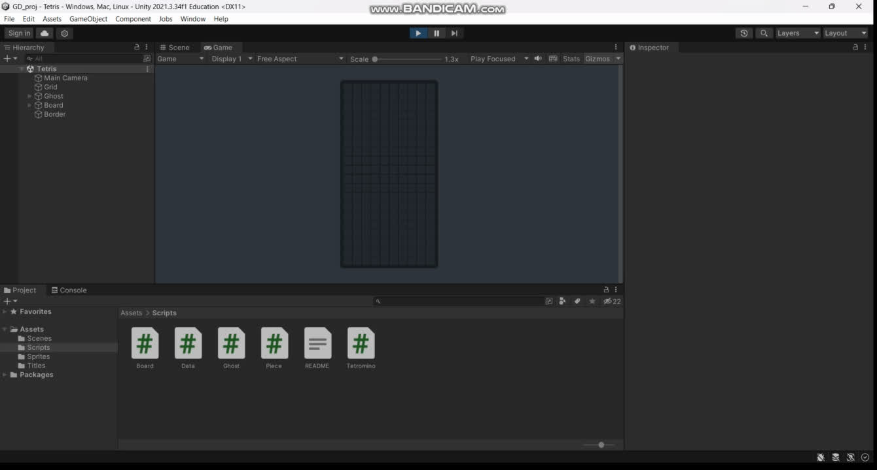
OUTPUT

Slide 14

THANK YOU

